Slide 1
Presentation of HIV/AIDS
Name
Institution
Date

Slide 2
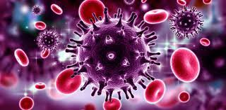
Introduction
HIV attacks human body cells, specifically the CD4 cells.
CD4 cells are protein molecules found on the surface of T-helper cells.
CD4 cells are commanded to manufacture the virus (Lu et al., 2018).
Two forms of HIV are HIV-1 and HIV-2.
HIV causes AIDS.
Notes:
Human immunodeficiency virus (HIV) refers to a virus that affects human body cells (white cells) which helps the body fight diseases. This virus can exist in two forms, which are either HIV-1 or HIV-2. HIV damages the human immune system, specifically the T-helper cells, making them more vulnerable to other diseases. T-helper cells are essential in the human body because they coordinate all the other cells involved in responding to the immune. CD4 is a protein molecule found in T-helper cells, which with infection of HIV the virus is manufactured hence endangering the health of the individual (Lu et al., 2018). HIV causes acquired immunodeficiency syndrome (AIDS) if not treated.

Slide 3

Background Information
The common theory of HIV origin is from chimpanzees in Central Africa.
HIV was discovered in the early 1980s.
HIV was discovered by Luc Antoine Montagnier and Robert Charles Gallo.
Notes:
One of the mejor believes is that HIV originated in the Democratic Republic of Congo in the 1920s. HIV was first discovered in Paris by Luc Antoine Montagnier and Robert Charles Gallo. The virus was discovered from a homosexual French patient in 1983. HIV/AIDS has been a global threat since when it was discovered. It is believed that HIV originated from a particular type of chimpanzee, Kinshasa, in Central Africa and later transmitted to human beings from the consumption of the meat of infected primates.

Slide 4
Pathogenesis
HIV destroys CD4+ cells to weaken the immune system.
AIDS is developed when the CD$+ cells is depleted to less than 200millitre of gland.
The virus replicates itself in the blood streams.
The five phases include; primary infection, asymptomatic, minor symptomatic, major symptomatic and severe symptomatic.
The body becomes unresistant to diseases when the CD4+ count is less than 200/ ml of the gland.
Notes:
HIV enters the human body, specifically into the bloodstreams and lymph nodes (Dimopoulos et al., 2017). HIV targets the immune system by destroying the CD4+ cells in the blood. Once the CD4 cells are depleted, the patient is prone to diseases. HIP patients develop AIDS when the CD4+ T is 200mm3 less and the HIV load is very high. Pathogenesis of HIV takes place in five phases. In the primary infection phase, the virus is active to replicate itself in the bloodstreams. This phase takes place between four and eight weeks of infection. During the asymptomatic stage, the virus is rapidly active in the body and continues to damage the immune system. The CD$+ count is between 500 and 800 per millilitre (ml) of the gland.
The infection goes to the symptomatic stage, which has three stages. In the minor symptomatic phase, the body begins to lose the ability to produce CD4+ cell. Opportunistic diseases such as herpes begin to display. The CD4+ cell count ranges between 300 and 500/ml of the gland. In the major symptomatic stage, the HIV/AIDS symptoms begin to show up and the CD$+ cell count reduces to range between 200 and 300/ ml of the gland. The HIV load is very high. Severe symptomatic is the last phase, which is also called full-blown. The CD4+ count is less than 200/ ml of the gland. The patient cannot resist diseases since the immune system is very weak.

Slide 5
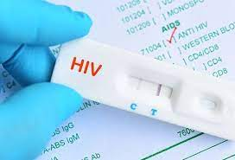
Diagnosis and Prognosis
HIV is diagnosed through blood and saliva testing.
Tests for HIV include; antigen tests, antibody tests and nucleic acid tests.
HIV results to AIDS if not treated.
HIV patients can live for more than forty years with appropriate treatment.
Life expectancy depends on the period of diagnosis and treatment.
Some conditions such as illegal drugs can reduce the life expectancy of HIV patients.
Notes:
HIV is diagnosed through the testing of blood or saliva (Limper et al., 2017). There are various tests used in diagnosing HIV, including antigen, antibody, and nucleic acid tests. Antigen test involves detecting antigens through drawing blood from veins. The antigens can be detected few weeks after HIV infection. An antibody test is done in saliva or blood within three to twelve weeks after infection. The antibody test involves detecting antibodies to HIV. A nucleic acid test is done in the blood to identify the actual virus. This test is the first test that can be done after an infection. When HIV is not treated, it results in AIDS, which takes around ten years. AIDS can lead to death in a period of three years. However, if the patient seeks medication accordingly, the individual can live for more than forty years with the virus. Therefore, the long-life expectancy of an HIV patient requires early diagnosis. Modern guidelines also increase the life expectancy of positive patients. However, some conditions such as illegal drugs and conditions like chronic hepatitis may decrease life expectancy.

Slide 6
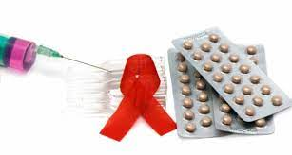
Treatment
HIV can be treated but cannot be cured (Lu et al., 2018).
Highly active antiretroviral therapy is used for treating HIV patients.
Common medicines used are; Nucleoside and nucleotide reverse transcriptase inhibitors, Non- nucleoside and nucleotide reverse transcriptase inhibitors, Protease inhibitors, Entry inhibitors and Integrase inhibitors.
The ability to mutate and resist medication makes HIV challenging to cure.
Notes:
According to Lu et al. (2018), there is a treatment for HIV but no cure despite the many drugs used to treat HIV patients. There are medicines developed to cater for patients in all stages of HIV, which are referred to as highly active antiretroviral therapy. This treatment includes nucleoside and nucleotide reverse transcriptase inhibitors, which block the viral enzyme effect. Non- nucleoside and nucleotide reverse transcriptase inhibitors are medicines that also prevent the effect of reverse transcriptase but are different from the NRTIs. Protease inhibitors are responsible for inhibiting viral enzymes used by the virus to turn strand of proteins into pieces that can be used. Entry inhibitors prevent HIV from entering cells. Integrase inhibitors impair the viral DNA. The virus can mutate and resists medication, which makes it challenging to find a specific cure (Lu et al., 2018). Treatment of HIV positive mother during pregnancy is important because it reduces the risk of infecting the unborn child.

Slide 7
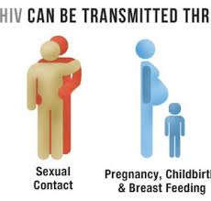
How HIV is Spread
HIV is contagious.
HIV can spread through;
Unprotected sex.
Blood contact.
Kissing.
Notes:
HIV can easily be spread from one person to another thus, it is a contagious virus. The most common way through unprotected sex. Sexual intercourse can be vaginal or anal. HIV can be spread from an infected to a healthy individual through blood contact, which can result from an organ transplant or blood transfusion. HIV can also be spread from mother to child in the process of giving birth or when breastfeeding. Sometimes, HIV can be spread through kissing.

Slide 8
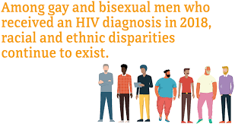
Groups of People Who are at Risk
Anyone can get HIV.
People in areas with high HIV victim population have higher risks.
Gays and bisexuals in the US have high rate of new infections.
Blacks and Hispanics have higher infection rates.
Notes:
HIV can infect anyone despite gender, race, age, ethnicity, area of residence, religion or sexual orientation. However, if an individual lives in an area with many people who have HIV, there is a high exposer to getting infected through sex or sharing injections (Lu et al., 2018). In the US, the rate of new HIV infection among gays and bisexuals is very high. Blacks and Hispanics have a higher infection rate than other ethnic and racial groups.

Slide 9
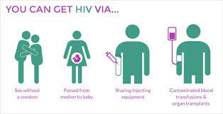
Etiology of HIV
Sexual intercourse can lead to HIV infection.
HIV can be caused through sharing of infected, contaminated needles.
HIV is transmitted through blood transfusion.
Notes:
HIV is contagious and people can get infected when they are in contact with infected semen, vaginal fluids, blood, breast milk and sometimes saliva. HIV is commonly caused by sexual intercourse (Lu et al., 2018). When a negative person gets involved in unprotected sex with a positive individual, the virus can easily be transmitted. Oral sex can also lead to transmission of HIV between a positive and negative person. HIV can be caused through sharing of infected, contaminated needles. When people share needles with an infected person in drawing tattoos, injecting drugs and piercing their body, the virus can easily be transmitted. Blood transfusion is another cause of HIV. When blood is transfused from an infected individual to a healthy individual, the virus is also transmitted. HIV can be transmitted from mother to child. An infected mother can transmit the virus to her child through breastfeeding, pregnancy, or when giving birth.

Slide 10
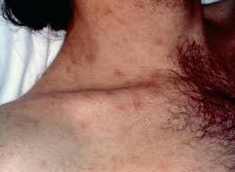
HIV Signs and Symptoms
The early of HIV/AIDS symptoms include;
Fever
Rashes and sore throat
Night sweats
Mouth ulcers
Muscle aches and swollen lymph nodes
Notes:
The first sign of HIV is fever, which is followed by other symptoms. Within the first four weeks of infection, most people experience symptoms related to flu. Some of these symptoms include rashes, sore throat, night sweats, mouth ulcers, chills, muscle aches and swollen lymph nodes. However, it is important to note that having these symptoms does not indicate HIV infection since other illnesses can cause them. If HIV is not treated, the body’s immune system is weakened and can lead to severe symptoms. These late symptoms include weight loss, diarrhea, pneumonia, extreme tiredness, sores in the genitals or mouth, high fever, swelling of lymph glands on the neck groin or armpits and memory loss or depression ((Lu et al., 2018).). These symptoms can also be related to other diseases and therefore, it is advisable to get tested. Most of the symptoms are associated with opportunistic infections since the body has a weak immune system.

Slide 11
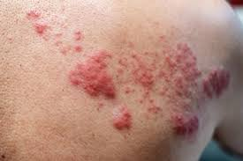
Continuation of HIV Signs and Symptoms
In the late stages when HIV is not treated, the symptoms are;
Weight loss.
Diarrhea and high fever.
Pneumonia and extreme tiredness.
Sores in the genitals or mouth.
Swelling of lymph glands on the neck, groin or armpits (Lu et al., 2018).
Memory loss or depression.

Slide 12
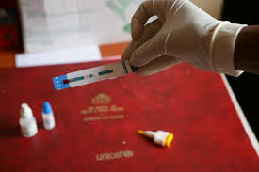
Prevention of HIV
HIV can be prevented though it cannot be cured. Prevention can be done through;
Use lubricated condoms during sex or PrEP before sex as prescribed.
Abstaining from sex is the best method.
Use sterilized blades in circumcision.
Avoid sharing needles.
Conducting blood testing before organ transplant or blood transfusion.
Expectant mothers should seek medical attention.
Regularly go for HIV testing to k ow status.
Notes:
One of the most advisable measures to prevent HIV is the use of condoms since sex is the highest contributing cause of infection. People should always use lubricated condoms when they are having oral, vaginal or oral sex. People can take PrEP as instructed by the medical specialist before having sexual intercourse (Eisinger & Fauci, 2018). Abstaining is the safest method of HIV prevention through sex. Circumcision should be conducted on males using sterilized blades. Circumcision helps reduce the chances of HIV transmission through sex in men due to the hard skin that forms on the tip of the penis. HIV can be prevented by avoiding sharing of needles and syringes which are not sterilized.
During organ or tissue transplants, HIV should be tested to trace any infection. Blood should also be tested before it is transfused to the receiver. Mothers living with HIV should seek medical treatment, especially when pregnant, to reduce the risk of transmitting the infection to their children. The risk of child infection during pregnancy, giving birth or when breastfeeding will be minimized. People are encouraged to take HIV tests regularly to be aware of their status (Eisinger & Fauci, 2018). Knowing HIV status is important because infected individuals will seek medical attention as early as possible and prevent transmitting it to other people. Healthy people will protect themselves from getting infected by the virus.

Slide 13
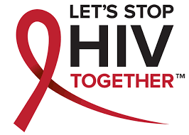
Importance of providing information on HIV/AIDS
This topic about HIV/AIDS is essential because;
People get informed about the disease and the measures to take.
People get encouraged to go for HIV testing.
Encourages positive people by giving them hope.
Positive people can minimize HIV transmission.
Negative people learn how to protect themselves from HIV.
People living with HIV are treated better and stigmatization is minimized (Kontomanolis et al., 2017).
Notes:
Through HIV/AIDS topics, individuals who have little information about the disease get informed and follow the preventive measures. This topic is very important because it encourages people to get tested for the virus regularly. Discussion of this topic enables individuals who test negative to learn how to live a healthy lifestyle and protect themselves from acquiring the virus. This topic also helps those people who have tested positive to live a healthy life by taking prescribed medication and exercising. Positive people get encouraged not to lose hope and protect themselves from transmitting the disease to other people. This topic informs people on the behaviors they should avoid to protect themselves from contracting and transmitting the disease. Through HIV/AIDS discussion, people learn how to treat and accept positive people in society properly (Kontomanolis et al., 2017).

Slide 14
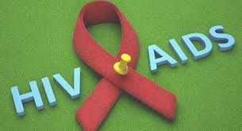
Facts about HIV/AIDS
There some facts associated with HIV, such as
It is curable but can be treated.
It can infect anyone.
Sexual intercourse is the common mode of transmission.
Poor people are prone to higher HIV infection rates.
Individuals with HIV can live a long life with treatment.
Notes:
HIV/AIDS is treated and prevented, but it is not curable. Any person can get HIV despite gender, age, race or social class. Transmission of HIV is widespread in teenagers compared to adults. HIV is transmitted highly through sexual intercourse. HIV infection is higher in areas with more people of lower economic status than those in high er socials class. Similarly, countries that are more developed tend to have lower HIV infections compared to underdeveloped countries. Individuals can live with HIV for many years as long as they take medication as prescribed, eat healthy food, and regular exercise.

Slide 15
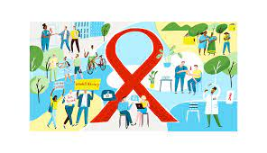
Conclusion
HIV causes AIDS and weakens the immune system of human body (Lu et al., 2018).
The body becomes prone to diseases.
HIV is transmitted through body fluids
Sex is the common HIV transmission method.
People should take precautionary measures.
Notes:
HIV is a virus that causes AIDS and it attacks the body cells responsible for disease protection hence weakening the immune system (Lu et al., 2018). Once the immune system is weakened, the body becomes prone to opportunistic diseases. HIV is caused by infected body fluids, which include semen, vaginal fluid and blood to a healthy person. Infection through sex is the most common transmission of HIV. People should abstain, avoid getting into contact with infected body fluids, carry out a blood test before organ transplant and avoid sharing sharp objects.

Slide 16
References
Dimopoulos, Y., Moysi, E., & Petrovas, C. (2017). The lymph node in HIV pathogenesis. Current HIV/AIDS Reports, 14(4), 133-140.
Eisinger, R. W., & Fauci, A. S. (2018). Ending the HIV/AIDS pandemic. Emerging infectious diseases, 24(3), 413.
Kontomanolis, E. N., Michalopoulos, S., Gkasdaris, G., & Fasoulakis, Z. (2017). The social stigma of HIV–AIDS: society’s role. Hiv/aids (Auckland, NZ), 9, 111.
Limper, A. H., Adenis, A., Le, T., & Harrison, T. S. (2017). Fungal infections in HIV/AIDS. The Lancet Infectious Diseases, 17(11), e334-e343.
Lu, D. Y., Wu, H. Y., Yarla, N. S., Xu, B., Ding, J., & Lu, T. R. (2018). HAART in HIV/AIDS treatments: future trends. Infectious Disorders-Drug Targets (Formerly Current Drug Targets-Infectious Disorders), 18(1), 15-22.

